Slide 1
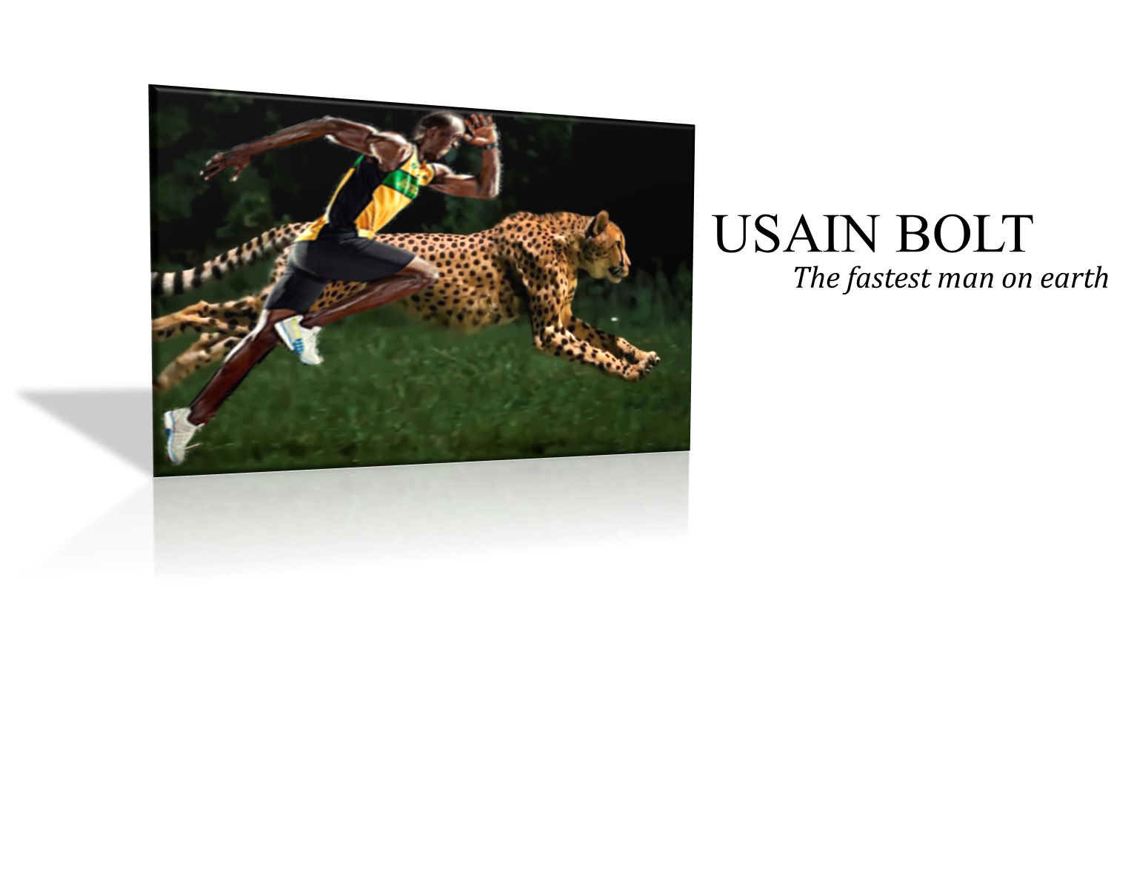
History continues…..
gifted
No limits……..
The moment
Legend’s Treasure
Break Down
Time spoke

Slide 2
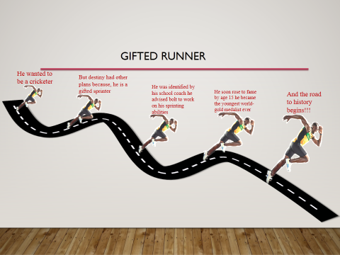
History continues…..
About
gifted
No limits……..
The moment
Legend’s Treasure
Break Down
Time spoke

Slide 3
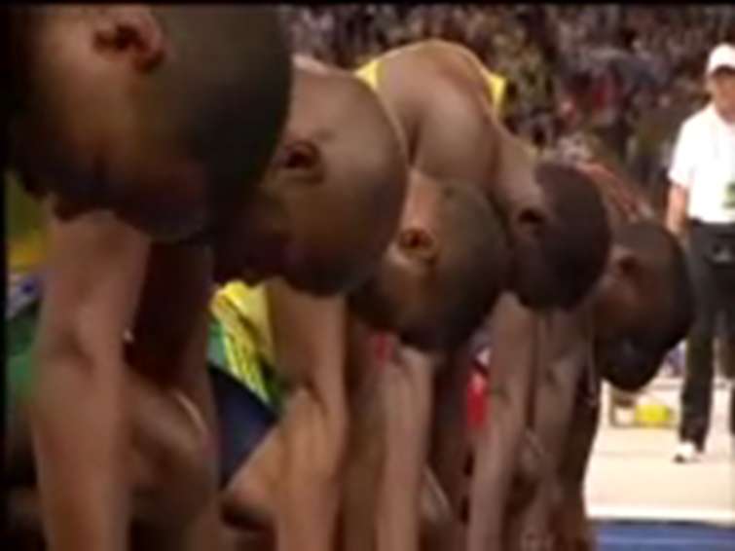
History continues…..
About
gifted
No limits……..
Break Down
Legend’s Treasure
The moment
Time spoke
About

Slide 4
No………. it was indeed not smooth, he had injury problems – scoliosis, a curvature of the spine, affecting his hamstrings
Extreme nervous breakdown before the international tournament
Multiple injuries all through his career did compel him to postpone his trainings at certain stages of his career.
“The workload I had leading up to the Olympics and even at the 2015 world championships meant there was so much pressure and stress that it just wasn’t fun anymore,” Bolt was quoted as saying by the Guardian.
History continues…..
About
gifted
No limits……..
Break Down
Legend’s Treasure
Time spoke
The moment

Slide 5
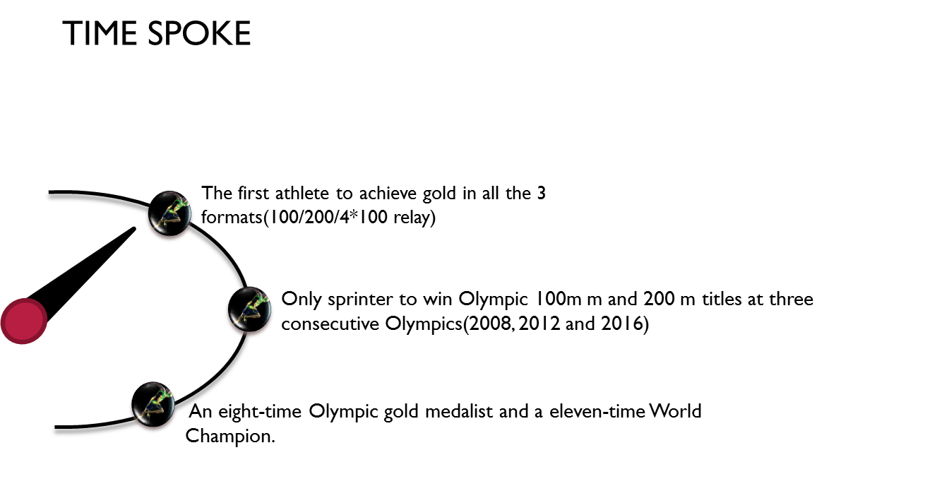
History continues…..
About
gifted
No limits……..
The moment
Legend’s Treasure
Break Down
Time spoke

Slide 6
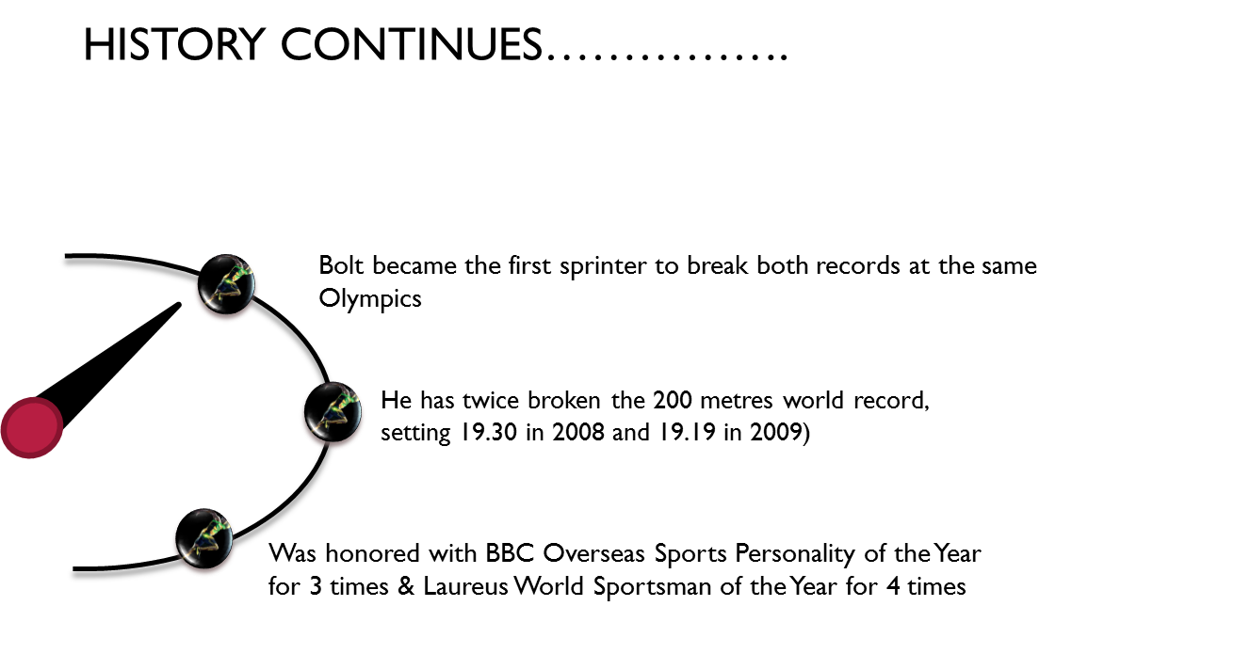
About
History continues…..
gifted
No limits……..
The moment
Legend’s Treasure
Break Down
Time spoke

Slide 7
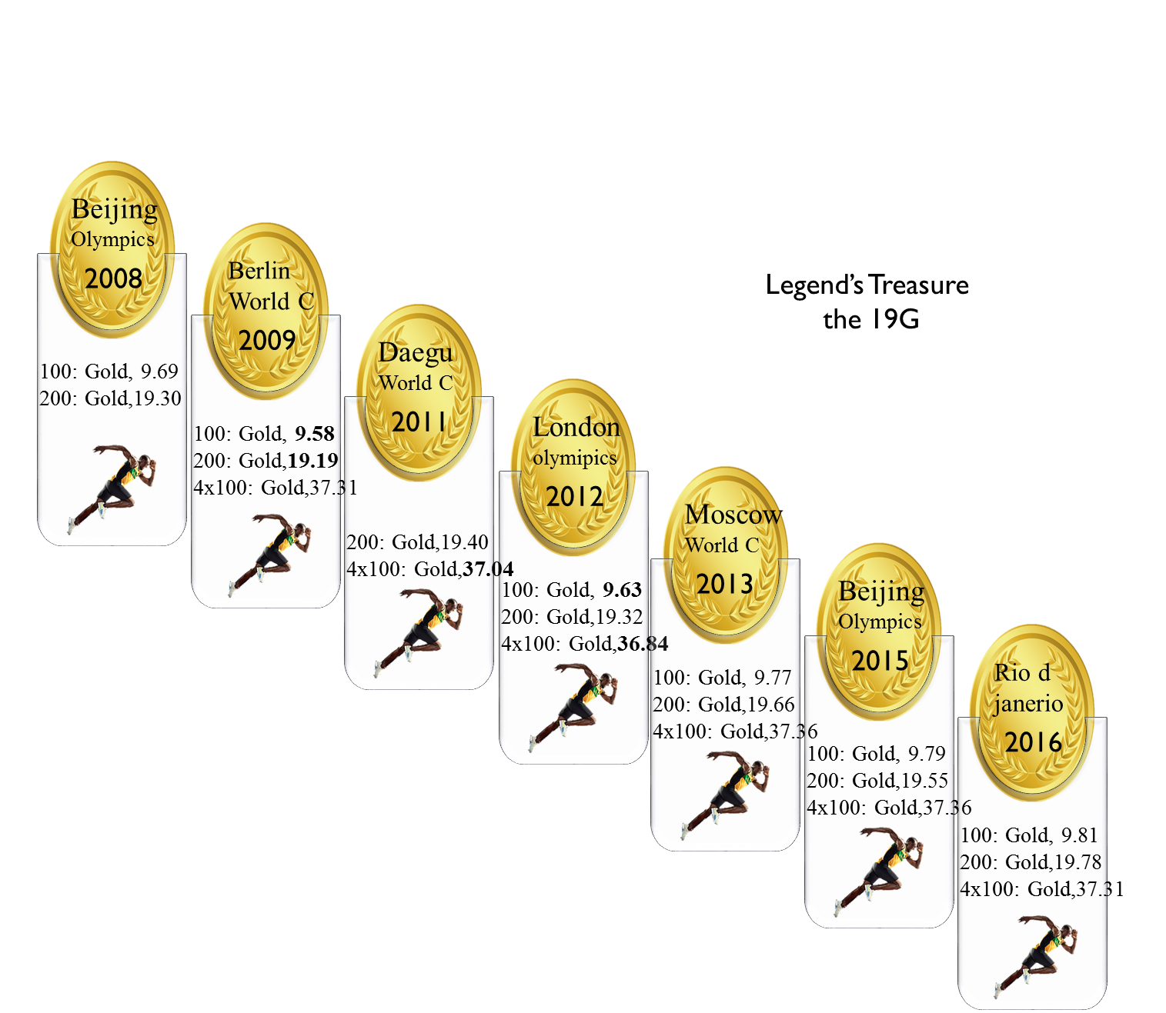
About
History continues…..
gifted
No limits……..
Legend’s Treasure
The moment
Break Down
Time spoke

Slide 8
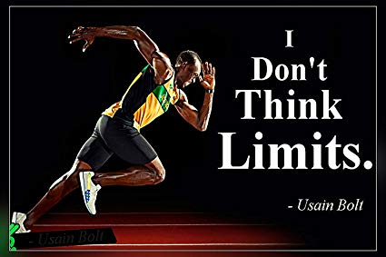
About
No limits……..
History continues…..
gifted
Legend’s Treasure
Break Down
Time spoke
The moment

